Slide 1
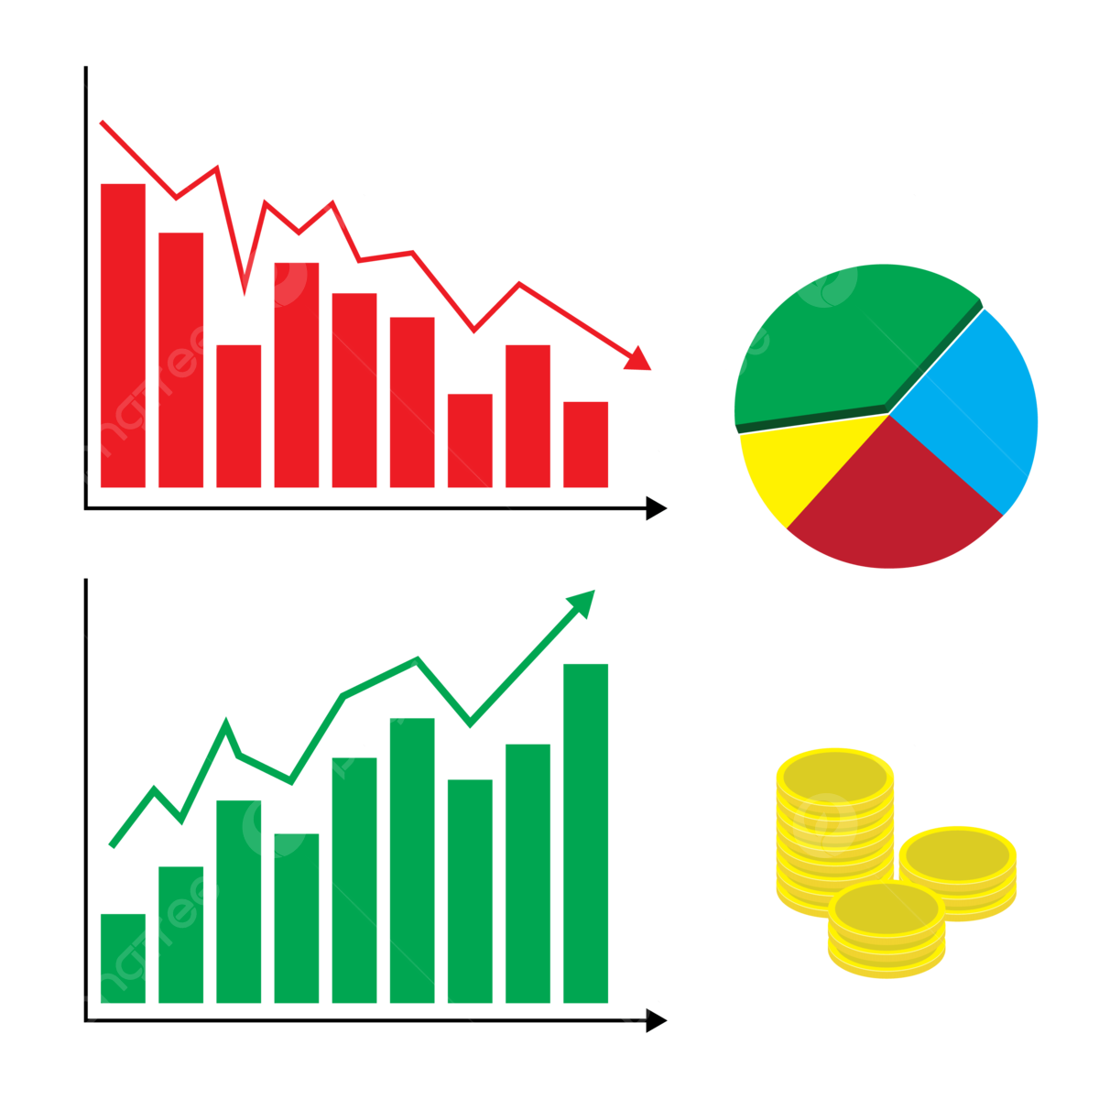



Using News Sentiment & Social Media Opinions to Drive Stock Investment Decisions
Twitter

Slide 2

Meet The Presenter
Mojeed Abisiga
Mojeed Abisiga
Sanusi Dangote
Data Scientist
Machine Learning Engineer
Masters in Informatics & Analytics

Slide 3
Contents
1
Introduction
2
Methods
3
Results
4
Next Steps

Slide 4
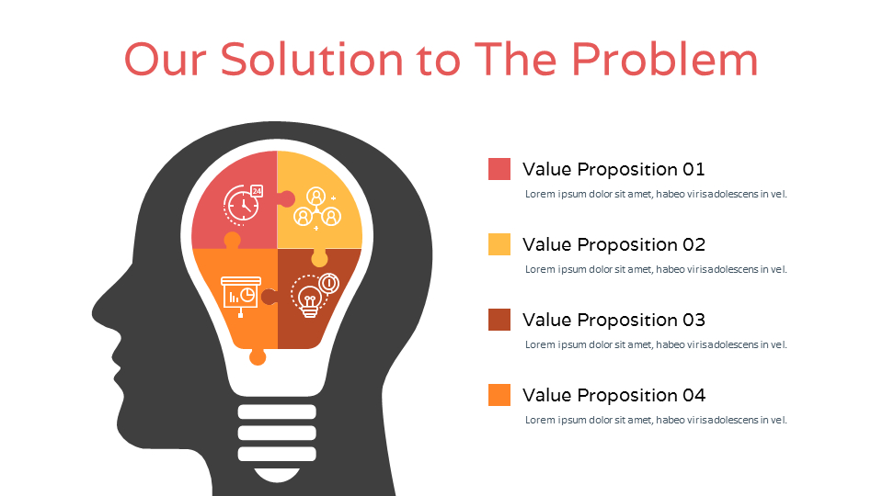
Introduction
The Problem
The Solution
Build a rich companies’ dashboard or report or set of visualizations that serve as a one-stop shop to get relevant information and insights that can be used by investors for making decisions on the kind of stocks or companies they should invest on.
1
The Use Case
This focused on aggregating relevant data points for international organizations that are key players in 3 major sectors (Energy, Financial Services, and Technology).
Our use case is a deep dive on thirty (30) organizations, spread across 3 different sectors (10 organizations per sector).
04
2
The Data
This case study utilized data sources such as Stock Analysis, and Twitter. Data extraction from Stock Analysis was achieved with R while that from Twitter was achieved with Python. Only tweets that for the past 2 weeks were collected because of Twitter API free access limitation.
The extracted data was afterwards, transformed into a more useable format.
3
The Result
The extracted data served as input to the charts that were generated in R, which visualizes vital organizational information and compares relevant KPIs between organizations that can be used to make decisions by investors

Slide 5
Data Sources & KPIs
Required Data Artefacts
stockanalysis.com
Twitter
Company Details – company name, employee counts, industry, sector, etc.
Company Financials – key operating data from financial reports, stock prices and market cap, net income etc.
Company Sentiment – analyst sentiments, noteworthy news updates etc.
Social Media – tweets, likes, retweets, location, date etc.
Company Details
Company Financials
Company News & Analyst Sentiments
Other stock market information
Terms and Conditions
https://stockanalysis.com/terms-of-use/
Tweets
Number of Likes
Number of Retweets
Date
Location
Author of Tweet
Number of Followers
Popularity of Tweet
Relevance of Tweet
Terms and Conditions
Twitter API being used

Slide 6
Approach
Identify
Extract & Execute
Visualize
2. Audit Field Work (including on-site visits, inspection) and Test & Measurement
Identified the required KPIs from the problem statement
Conducted research to find relevant data sources for these KPIs. Also verified from their Terms of Use page that the data was available for commercial use and that scraping is allowed
Inspected the various data sources’ webpages to identify patterns that were used in extracting the data
Got access to the Twitter API
Extracted/scraped the required data points using Python and R
Cleaned data and checked for data quality using Natural Language Processing (NLP) techniques
Made use of R for the visualizations
Key Activities
Global Trends

Slide 7
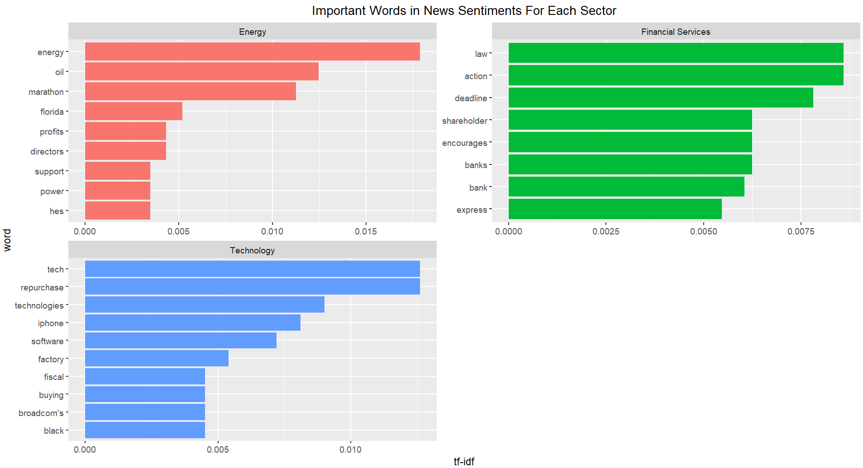

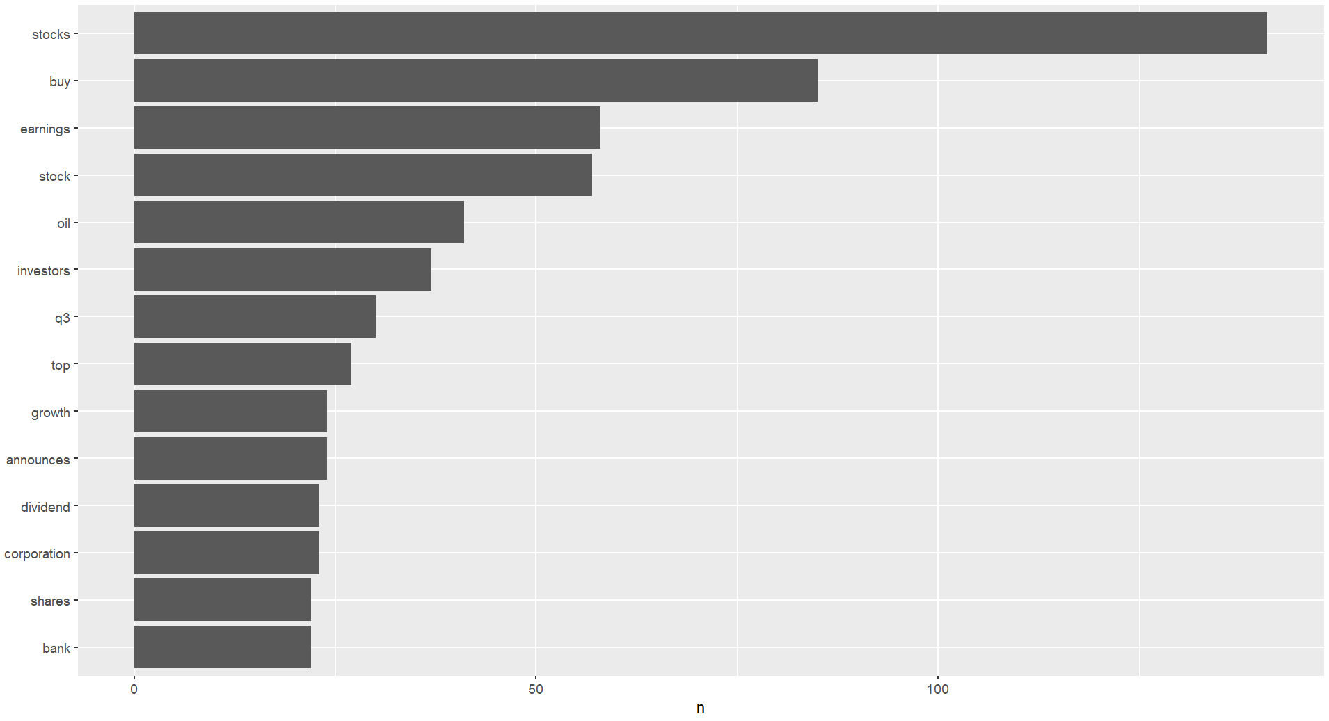
Most Frequent Words in News
Result:
Key Findings
As expected, all news about the companies are mostly around stocks, earnings, shares, investors, since we got the news from stock analysis website.
Key Findings
As expected, the Technology Sector news consist mostly of words like tech, technologies, iphone, software etc.
And for Energy Sector, words like energy, oil, power etc.

Slide 8
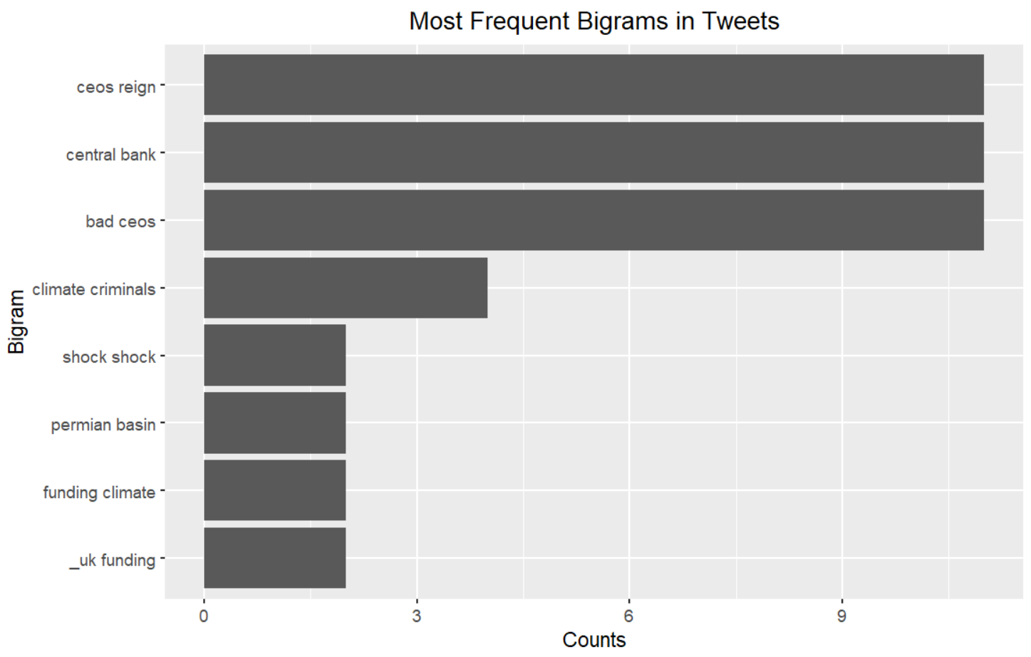
Most Frequent Bigrams in Tweets with Negative Sentiment
Result:
Key Findings
Looks like the actions of the CEOs of companies are making these companies have bad sentiments on social media
It seems there are some criminal acts regarding fundings on climate in the UK that causing negative sentiments

Slide 9
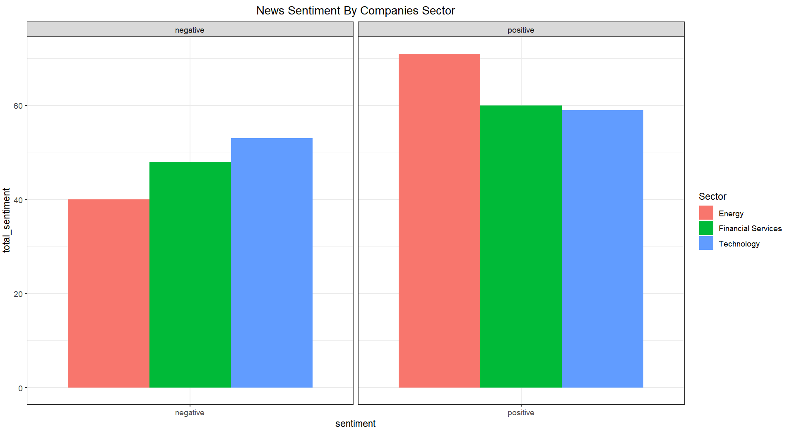
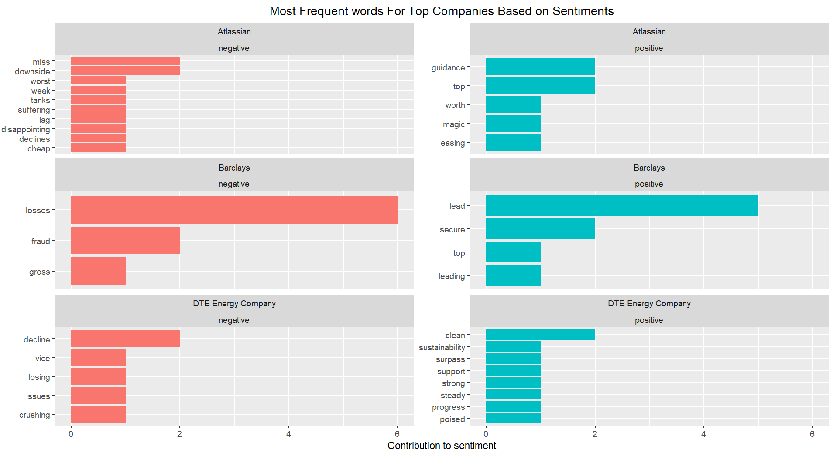
Result:
News Most Frequent Words and Sentiments by Sector
Key Findings
These are the most used words (for both positive and negative sentiments) in the News of company with the most negative sentiment in each sector
Barclays is experiencing so much fraud activities
Key Findings
The Energy sector had the least negative sentiment and the most positive sentiment, so the investor might want to consider investing in a company in these sector

Slide 10
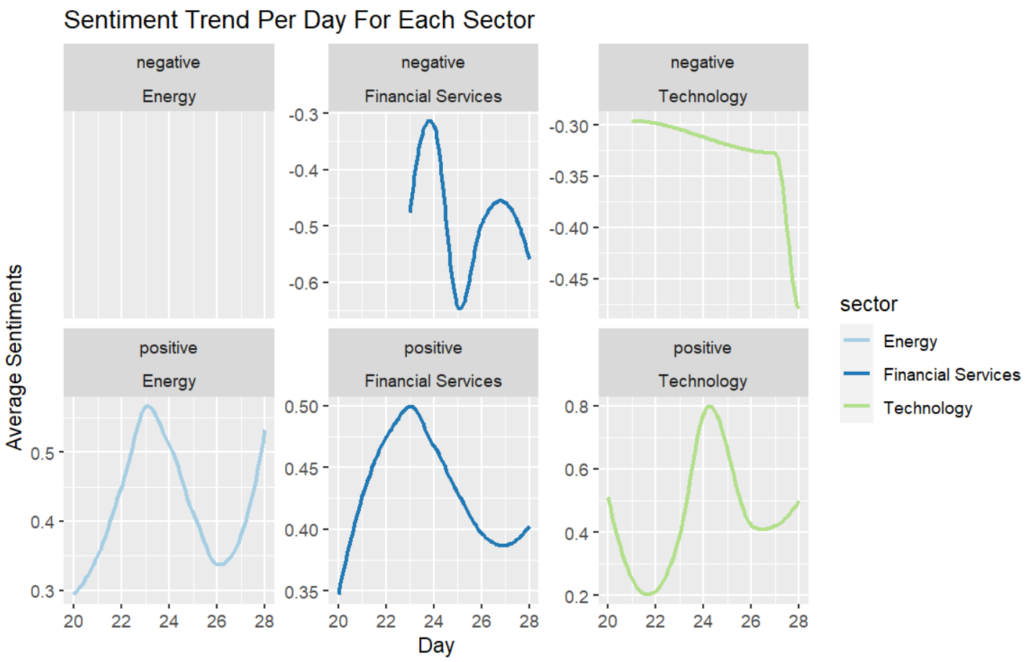
Result:
Twitter Sentiments Trend over 2 Weeks
Key Findings
The Technology Sector looks like a no-go area for potential investors, the twitter sentiments around companies in this sector has been drastically increasing towards the negative end without any increase
The Energy sector looks good, with maybe only 1 day or no day of negative sentiment, and constantly fluctuating amount of positive sentiments

Slide 11
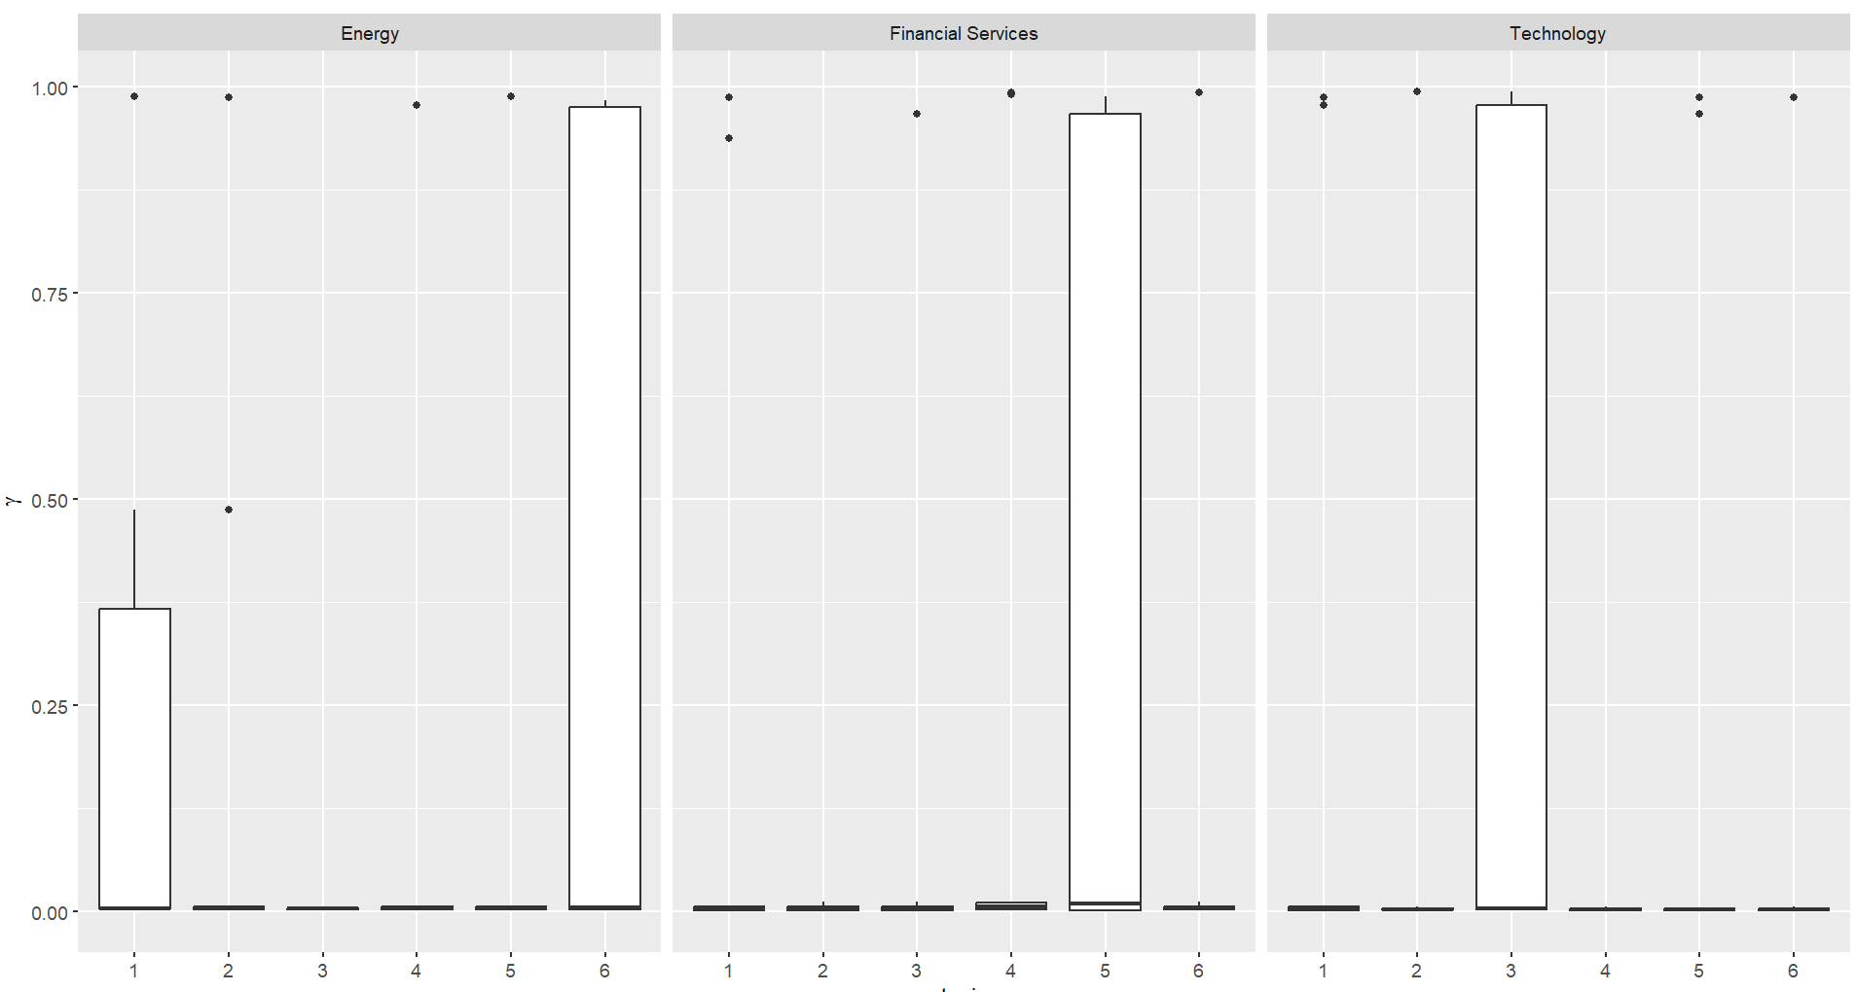
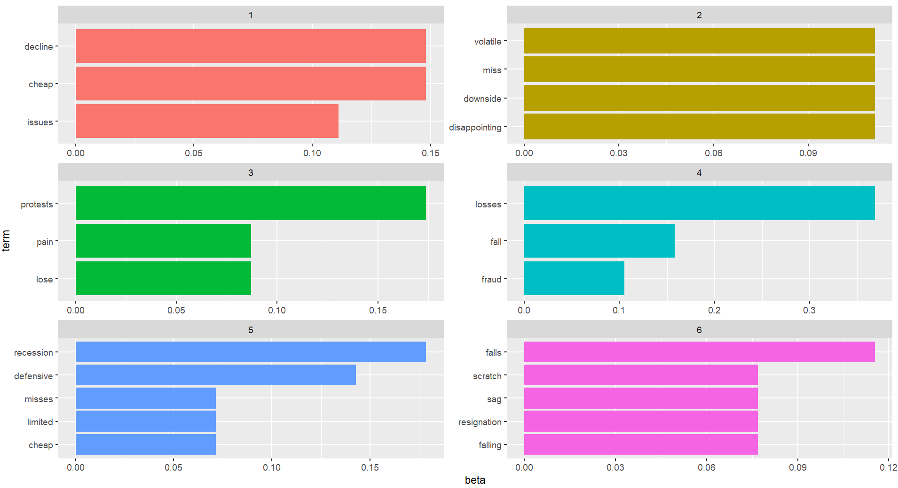
Result:
Topics of News with Negative Sentiments
Association of Topics with Sectors
News Topics & Common Words
The Financial Services Sector is solely about topic 5, which emphasizes recession
The Technology Sector is solely about topic 3, which emphasizes protests and loses
The Energy Sector is a mix of two topics, fairly topic 1 and mainly topic 6; talking about resignations, declines, issues etc.

Slide 12
Next Steps
Including more Sectors and Industries
Including other Social Media Platforms (apart from Twitter)
Turning this into an Interactive Dashboard
Deep-diving into comparison with some Financial Indicators

Slide 13

Thank you
Questions?

